Slide 1

ETHER & WEI

Slide 2
WHAT ARE ETHER (ETH) AND WEI?
Ether (ETH): Ether is the native cryptocurrency of the Ethereum blockchain. It serves as a medium of exchange for transactions, gas fee, and rewards for miners.
Wei: Wei is the smallest unit of Ether, representing the base denomination. All other denominations of Ether are derived from Wei. 1 Ether = 10^18 Wei
Notes:
Denomination meaning in the context of money can be well understood by thinking of place values. The place values are ones, tens, hundreds, thousands, and so on. $1, $10, $100 are similar to place values of units, tens, and hundreds 1.

Slide 3
WHY USE WEI?
Precision: Floating point numbers can suffer from precision issues. When working with money or assets, precision is crucial. Even tiny errors can add up to significant amounts when dealing with large quantities or high-value assets
Let's say the contract has to split 1 Ether among 3 people. In exact calculation, each person should get 0.3333... Ether.
0.3333 Ether, which sums up to 0.9999 Ether when multiplied by 3, not 1 Ether. This leaves 0.0001 Ether unallocated.
Notes:
Not 100% removing all the precision issues instead completely eliminating the precision issue.

Slide 4
WHY USE WEI?
Determinism: Floating point operations can sometimes lead to non-deterministic behavior due to precision errors and differing implementations on different machines.
As a simple example, imagine a smart contract that does the operation 0.1 Ether + 0.2 Ether. On one machine, the result might be 0.3 Ether. But due to the quirks of floating-point arithmetic and differences between machines, another machine might calculate the result as 0.30000000000000004 Ether.
Gas Costs: More complex operations, like floating point arithmetic, could potentially cost more gas to execute on the EVM, making transactions more expensive.
Notes:
Not 100% removing all the precision issues instead completely eliminating the precision issue.

Slide 5
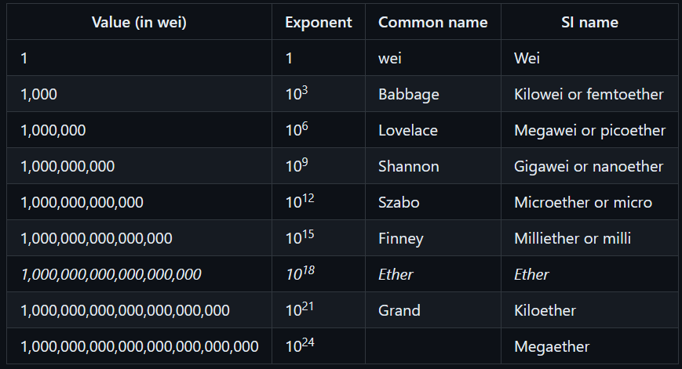
SYMBOLS AND CONVERSION RATES

Slide 6
QUESTION
You've just received a transaction of 500,000,000,000,000 Wei. How much Ether is this equivalent to?
A) 0.0005 Ether
B) 0.005 Ether
C) 0.05 Ether
D) 0.5 Ether

Slide 7
ANSWER
You've just received a transaction of 500,000,000,000,000 Wei. How much Ether is this equivalent to?
A) 0.0005 Ether
B) 0.005 Ether
C) 0.05 Ether
D) 0.5 Ether

Slide 8
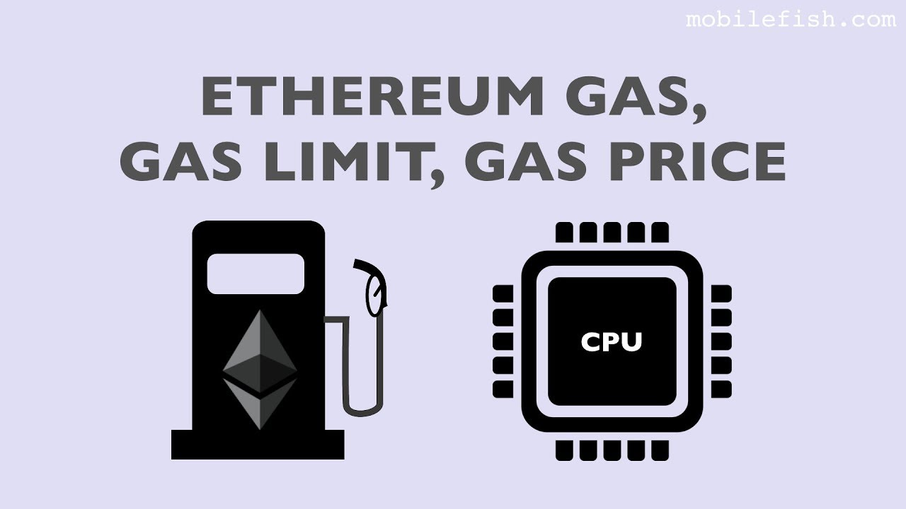


Slide 9

WHAT IS GAS?
Gas represents the unit of computational effort required to execute operations on the Ethereum blockchain.
Each operation, such as executing a smart contract or transferring Ether, consumes a specific amount of gas.

Slide 10
WHY DO WE USE GAS?
Resource Management: Gas is used to manage resources and prevent abuse or spamming of the Ethereum network.
Dust Attacks
Fair Compensation: Miners are compensated with gas fees for the computational work they perform to validate transactions and execute smart contracts.

Slide 11
GAS PRICE AND ITS SIGNIFICANCE
Gas Price is the amount of Ether a user is willing to pay for each unit of gas.
Gas Price determines the priority and speed of transaction processing on the Ethereum network.
Higher Gas Prices incentivize miners to prioritize and include transactions in blocks more quickly.

Slide 12
FORMULA
Gas = Gas Price per unit(wei) x Gas Used(operations)
Gas Limit represents the maximum amount of gas a user is willing to consume in a transaction.
Example: Total Gas = 20 Gwei * 10,000 gas.
Total gas needed = 200,000 Gewi.
Example:
Gas Limit = 3,00,000 Gwei
Returned gas = 100,000 Gwei

Slide 13
Opcodes(Operations Codes)
Opcode | Gas Cost
ADD | 3
MUL | 5
SUB | 3
DIV | 5
SLOAD | 800
SSTORE | 5000

Slide 14
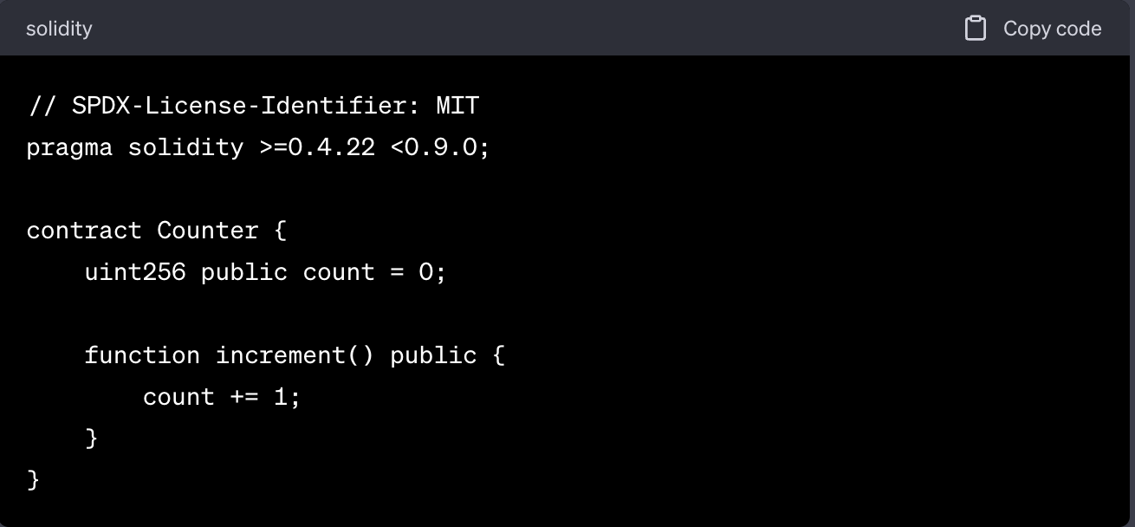
Gas Used Example

Slide 15
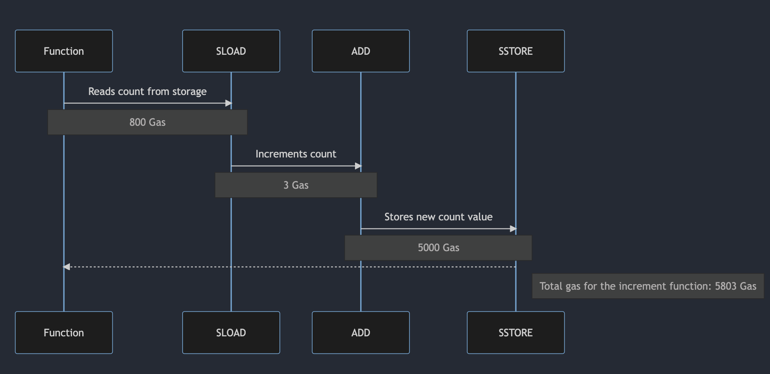
Gas Used Example Continued….

Slide 16
Gas Used Example Continued….
The increment function simply increments the count state variable by one.
Breakdown by opcode and gas costs:
SLOAD: Reads the current value of count from storage.
Gas cost = 800 gas.
ADD: Adds 1 to the current count value.
Gas cost = 3 gas.
SSTORE: Stores the new value of count.
Gas cost = 5,000 gas (because we're incrementing a non-zero value).
Total gas for the increment function:
Total gas = 800 (SLOAD) + 3 (ADD) + 5,000 (SSTORE) = 5,803 gas.

Slide 17
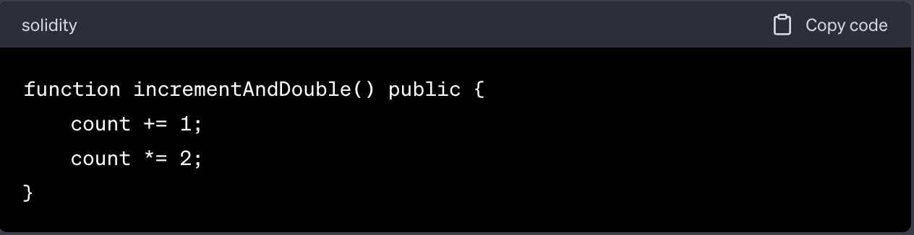
Quiz Time
Calculate Gas Cost

Slide 18
Answer
Breakdown by opcode and gas costs:
SLOAD: Reads the current value of count from storage.
Gas cost = 800 gas.
ADD: Adds 1 to the current count value.
Gas cost = 3 gas.
SSTORE: Stores the new value of count.
Gas cost = 5,000 gas.
SLOAD: Reads the updated value of count from storage.
Gas cost = 800 gas.
MUL: Doubles the current count value.
Gas cost = 5 gas.
SSTORE: Stores the final value of count.
Gas cost = 5,000 gas.
Total gas for the incrementAndDouble function:
Total gas = 800 (SLOAD) + 3 (ADD) + 5,000 (SSTORE) + 800 (SLOAD) + 5 (MUL) + 5,000 (SSTORE) = 11,608 gas.

Slide 19
Gas Example
Gas used = 5000
Gas Price per Unit = 1000 wei
What’s the total gas = 5000 * 1000 wei = 5,000,000 gas

Slide 20
Gas Quiz
Calculate Gas, where;
Gas used = 100 units
Gas Price = 9900 Wei

Slide 21
Gas Quiz Answer
Calculate Gas, where;
Gas used = 100 units
Gas Price = 9900 Wei
Gas = 100 * 9900 = 990,000 Wei

Slide 22
Gas Limit Example
Gas used = 5000
Gas Price = 1000 wei
Gas = 5000 * 1000 wei = 5,000,000 Wei
Gas Limit = 6,000,000 Wei
Returned Gas = 6,000,000 Wei - 5,000,000 Wei = 1,000,000 Wei

Slide 23
Gas Limit Quiz
Gas used = 4000
Gas Price = 100 wei
Gas Limit = 9,000,000 Wei
Returned Gas = ?

Slide 24
Gas Limit Quiz
Gas used = 4000
Gas Price = 100 wei
Gas Limit = 9,000,000 Wei
Returned Gas = 9,000,000 Wei - 4,000,000 Wei = 5,000,000 Wei.

Slide 25
Quiz
Gas used = 4000
Gas Price = 1000 wei
What should be minimum Gas limit ?
What will happen is the gas limit is 3,500,000 ?

Slide 26
Quiz
Gas used = 4000
Gas Price = 1000 wei
What should be minimum Gas limit ? 4000 * 1000 = 4,000,000 Wei.
What will happen is the gas limit is 3,500,000 ? Transaction will fail.

